Slide 1

RSMG
Institutionen för data- och informationsteknik 2012-05-21
Objektorienterat programmeringprojekt TDA367/DIT211 vt 2012
Robots Stole My Girlfriend
A game by
Daniel Jonsson Johan Grönvall Johan Rignäs

Slide 2
Introduction
Purpose of application
General characteristics of application
Scope of application

Slide 3
Purpose of application
Create a game
Easy to use

Slide 4
General characteristics of app.
Supportability
Navigation
Objects in game
(Tiles)
Character
Enemies
Items
Upgrades

Slide 5
Scope of application
The game will only have a single player mode.
The levels will be unlocked one after another in a linear fashion.
The player will only be able to shoot straight forward.
We won’t use a physics engine.
The levels won’t be hardcoded. Instead we will store them as XML files in a directory in the game folder.
The player will only be able to have one saved game at a time.

Slide 6
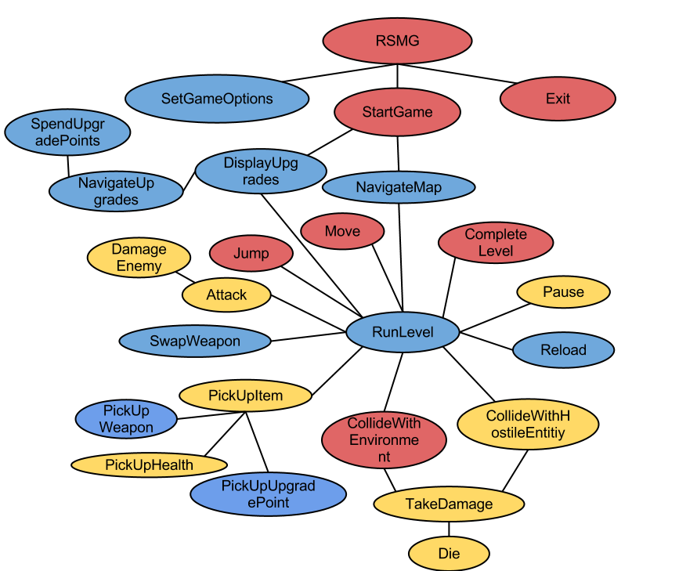
Use Cases

Slide 7
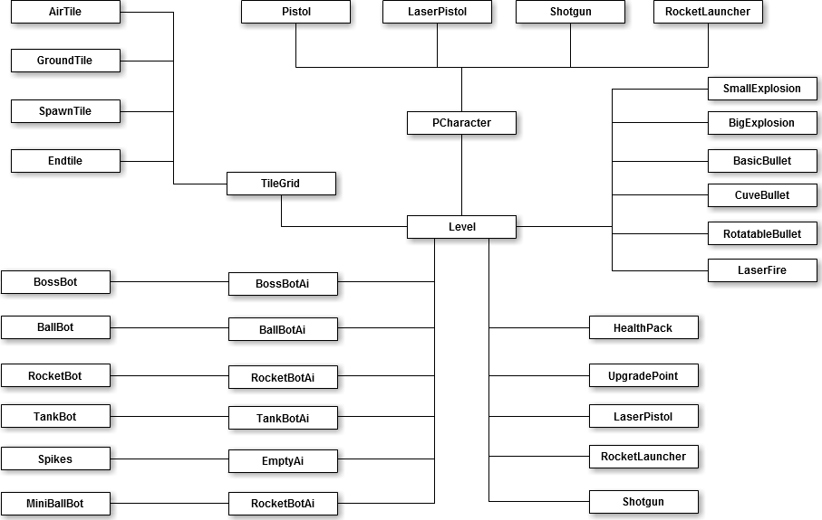
Model Design

Slide 8
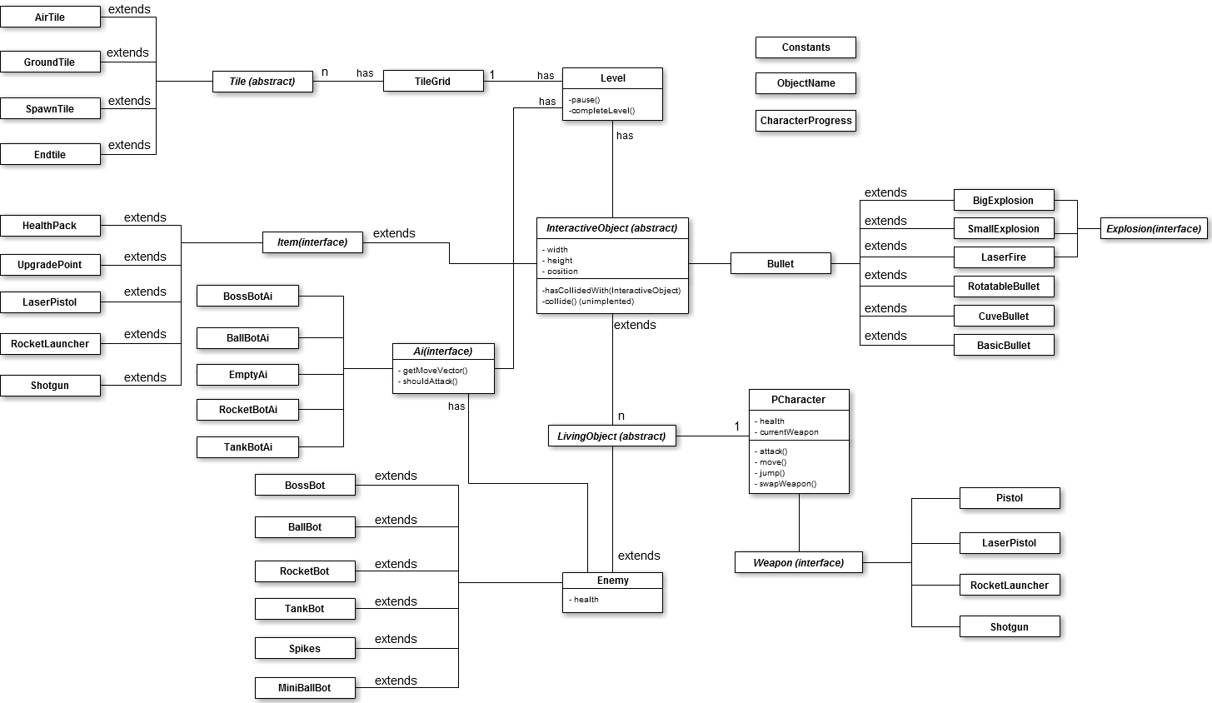
Domain Design

Slide 9
Demo

Slide 10
System Design - SDD
Strong parts

Slide 11
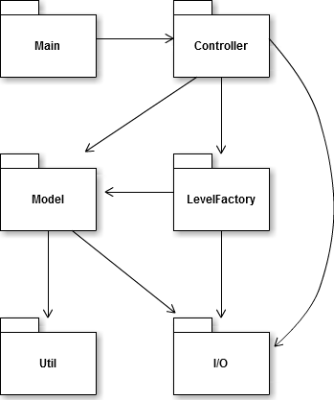
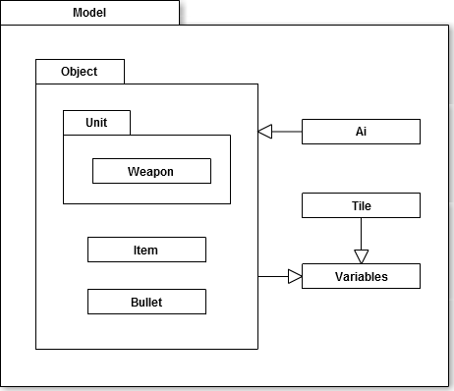
System Design - SDD
Package structuration

Slide 12
System Design - SDD
MORE STRONG PARTS:
- Slick
- Developed in a very dynamic way.
- Map editor

Slide 13
System Design - SDD
Weak parts:
- Non multi thread = decreased performance?
- Java not suitable for games
- Kind of not MVC

Slide 14
Technical solutions
Collision between tiles and objects
How to easily draw objects from the model

Slide 15
Collision between tiles and objects
(4,3)
(6,3)
(4,5)
(6,5)
for (int x = leftX; x <= rightX; x++) {
for (int y = topY; y <= bottomY; y++) {
if (grid[y][x].isSolid())
return true;
}
}
return false;
for (int x = leftX; x <= rightX; x++) {
if (grid[bottomY][x].isSolid()) {
return object.getY() + object.getHeight() - bottomY * Constants.TILESIZE;
}
}
return 0;

Slide 16
How to draw objects from the model
Model
public enum ObjectName {
...
HEALTH_PACK, UPGRADE_POINT, LASER_PISTOL,
ROCKET_LAUNCHER, SHOTGUN, PISTOL;
}
public abstract class InteractiveObject {
private ObjectName name;
public ObjectName getName() {
return name;
}
}

Slide 17
How to draw objects from the model
View
private Map<ObjectName, Renderable> items;
items = new EnumMap<ObjectName, Renderable>(ObjectName.class);
Image healthPack = new Image(folderPath+"healthPack.png", false, filter);
Image upgradePoint = new Image(folderPath+"upgradePoint.png", false, filter);
...
items.put(ObjectName.HEALTH_PACK, healthPack);
items.put(ObjectName.UPGRADE_POINT, upgradePoint);
...
private void drawItems() {
for (Item item : level.getItemList()) {
items.get(item.getName()).draw(item.getX(), item.getY());
}
}

Slide 18
Summary
- Make a game
- Make the game dynamic
- Make a map editor

Slide 19
Questions?

Slide 20
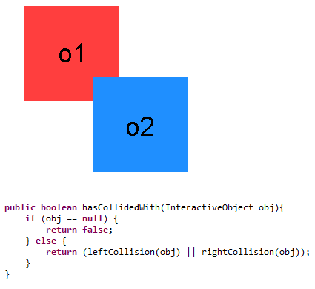
Collision Detection
o2.hasCollidedWith(o1);
True or False?

Slide 21
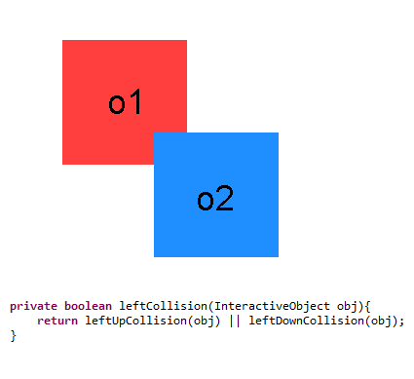
Collision Detection
Collision from the Upper- or Downside?

Slide 22
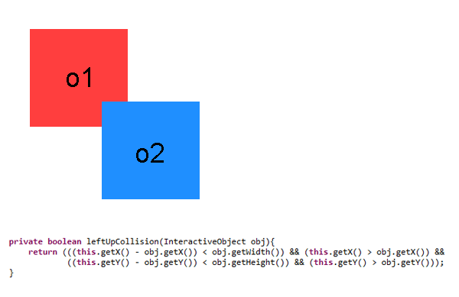
Collision Detection
- Check intersect
- Check side

Slide 23
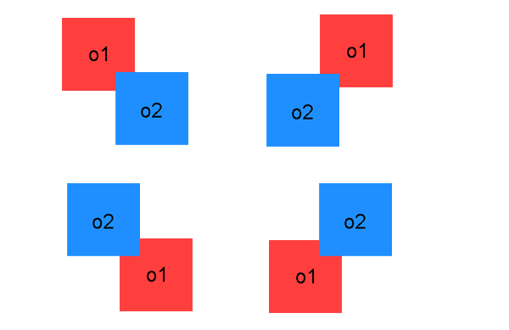
Collision Detection
Cover all cases

